Slide 1


EDA - Project
Pål Fylling Helland

Slide 2
Problem Statement
Sales teams often lack a clear, data-driven understanding of regional performance, making it difficult to identify growth opportunities and optimize resources. This project aims to analyse and visualize regional sales data to uncover trends, evaluate profitability, and support strategic decision-making.

Slide 3
Approach
Dataset was provided so Business understanding and Data gathering was already done.
Data preparation/cleaning – check for missing data
EDA – Exploratory Data Analysis
Presenting and visualisation of key insights

Slide 4
Data Overview
Regional Sales Data
Sales Orders | Customers | Regions | State Regions | Products | 2017 Budgets
Customer Name Index | Customer Index | id | Column1 | Index | Product Name
OrderDate | Customer Names | name | Column2 | Product Name | 2017 Budgets
OrderNumber |  | county | Column3
Channel |  | state_code
Currency Code |  | state
Warehouse Code |  | type
Delivery Region Index |  | latitude
Product Description Index |  | longitude
Order Quantity |  | area_code
Unit Price |  | population
Line Total |  | households
Total Unit Cost |  | median_income
 |  | land_area
 |  | water_area
 |  | time_zone

Slide 5
Project workflow
Loading dataset into Pandas dataframe
Inspect data: shapes, head, dtypes
Clean: Type-fix, check for null
Join sheets
Plot and compare categories: time, regions, products, channels
Conclude and present key findings

Slide 6
Key insights

Slide 7
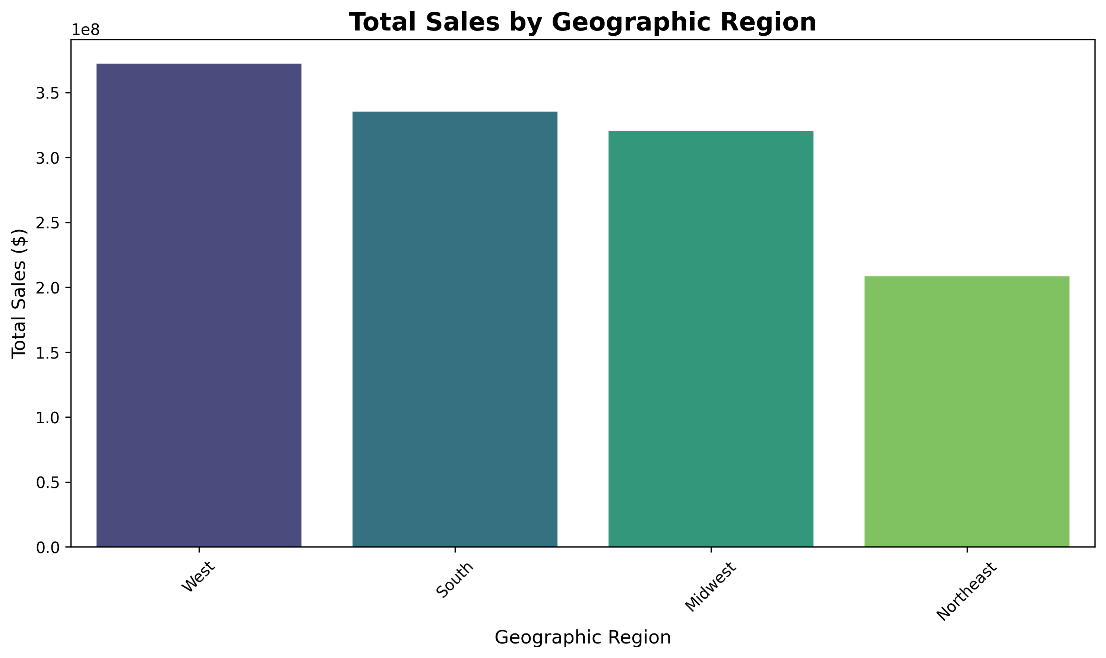
West leads total sales; South≈Midwest; Northeast lowest

Slide 8
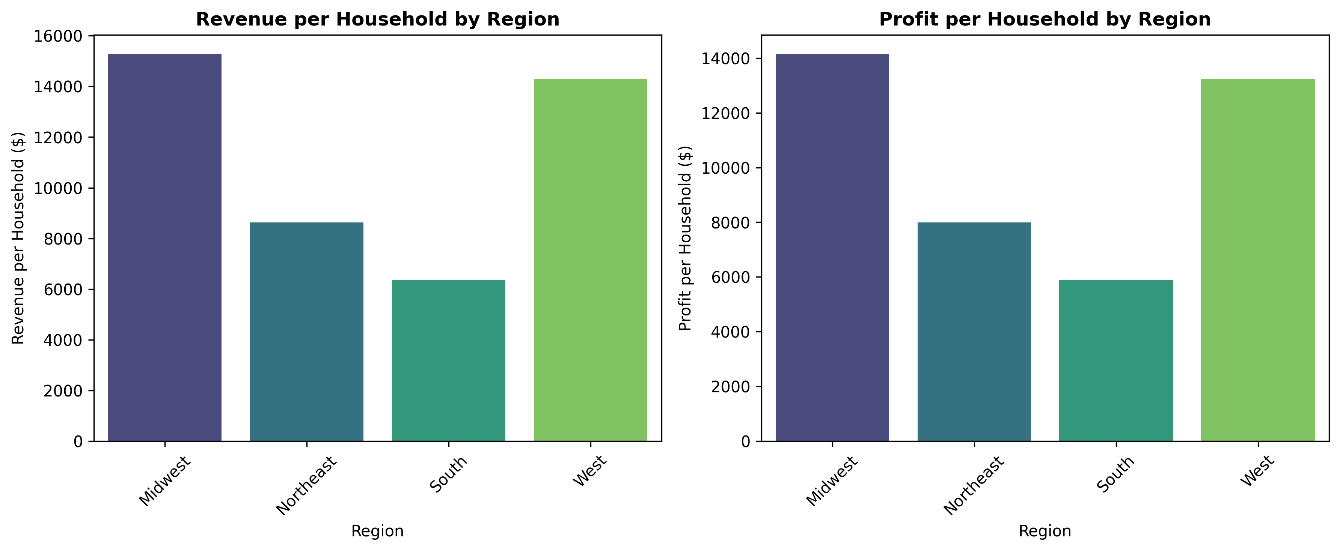
On a per-household basis, Northeast leads; West runner-up
Relative sales data / efficiency
Revenue and profit divided by number of households in the region.
Northeast comes out on top with West as runner up.

Slide 9
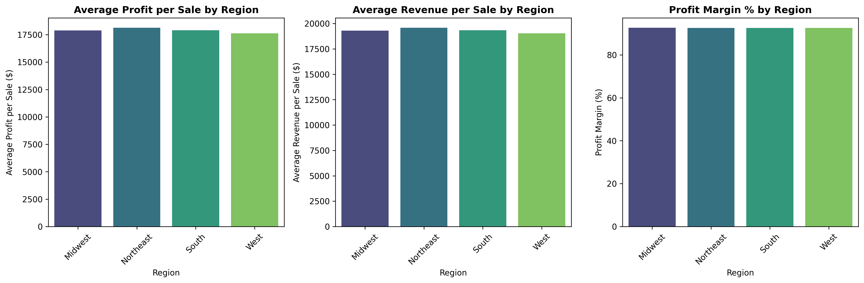
Unit economics are nearly identical across regions
Average profit per sale, average revenue per sale, and margin % are nearly identical across regions.

Slide 10
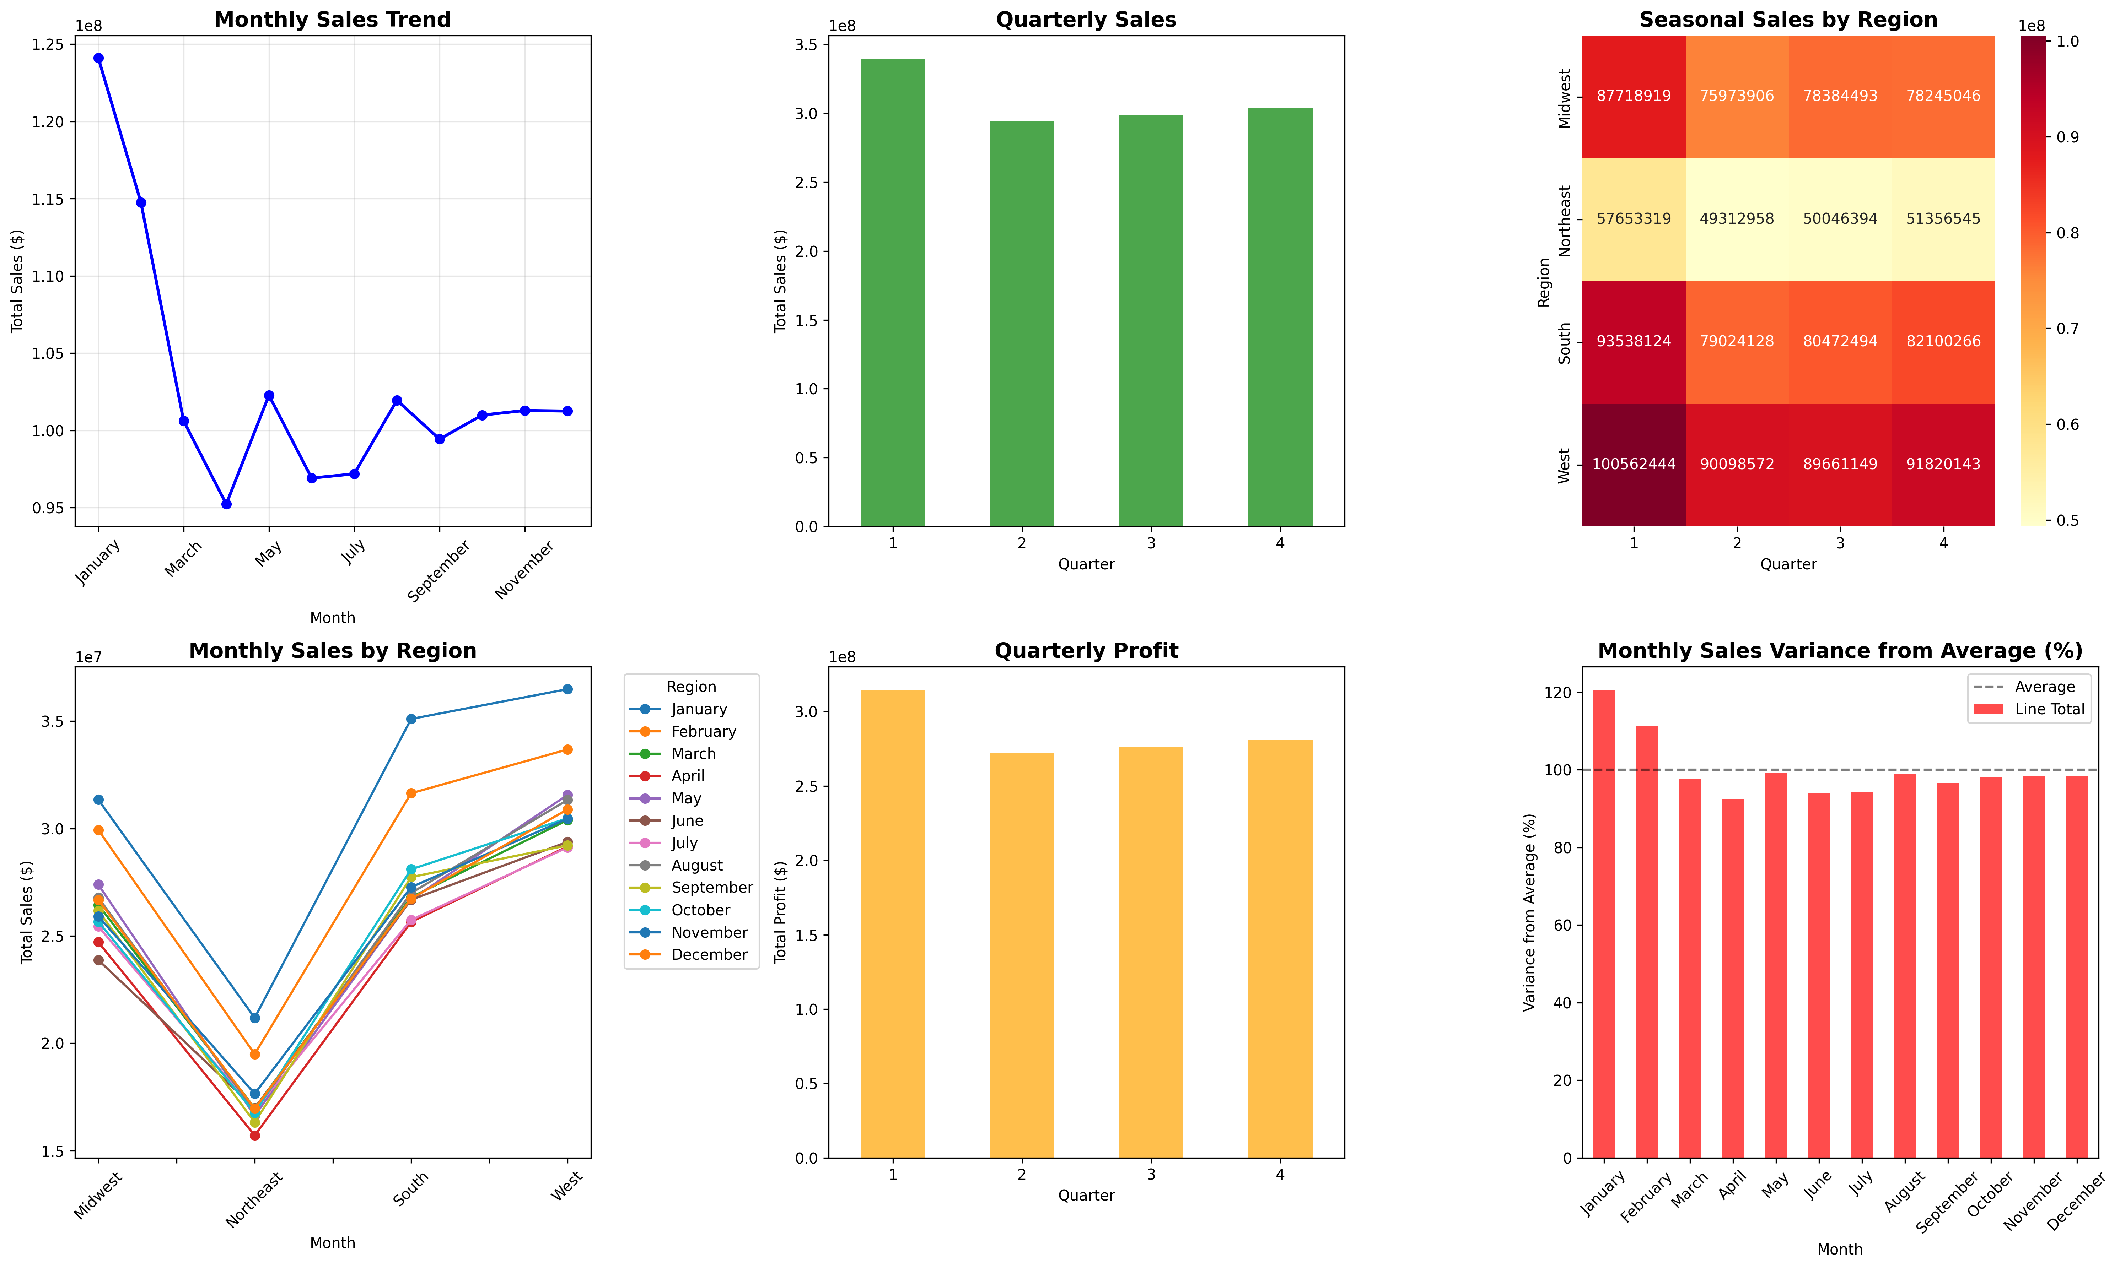
Clear business-wide seasonality: Q1 peak, Q2–Q3 dip, Q4 recovery
Q1 is the peak; Q2–Q3 dip; Q4 recovery—same pattern across all regions.

Slide 11
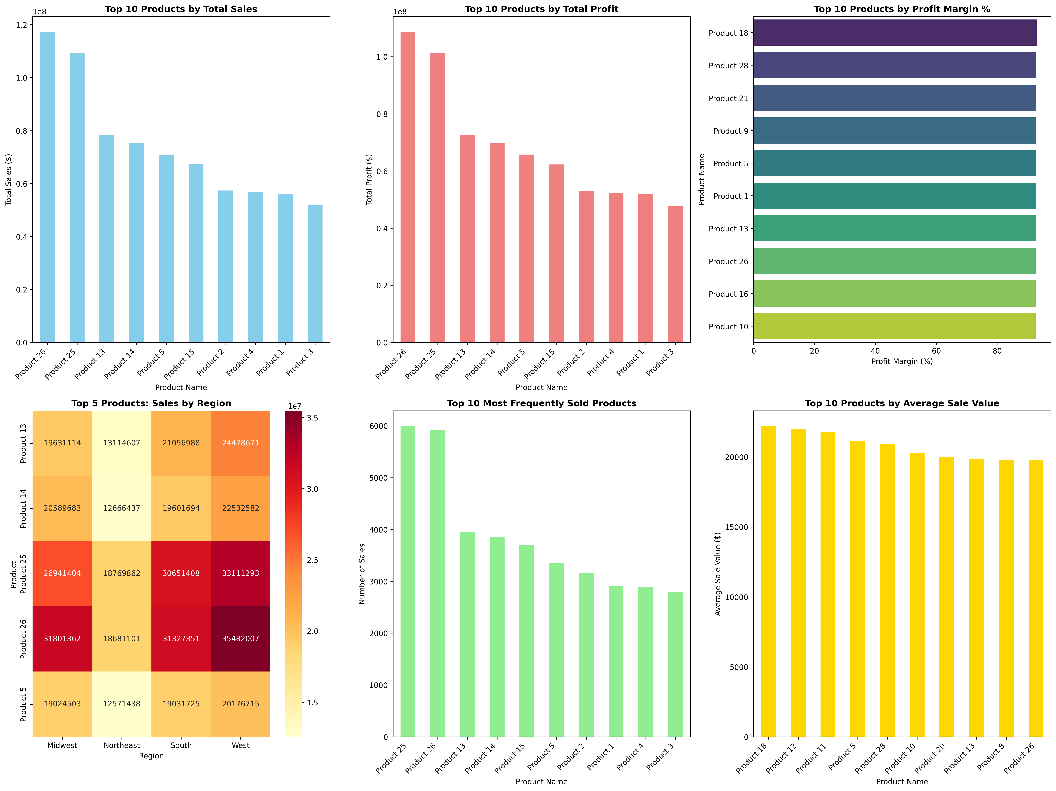
A few star products (25/26) drive most sales and profit
Product 25/26 are the top performers.

Slide 12
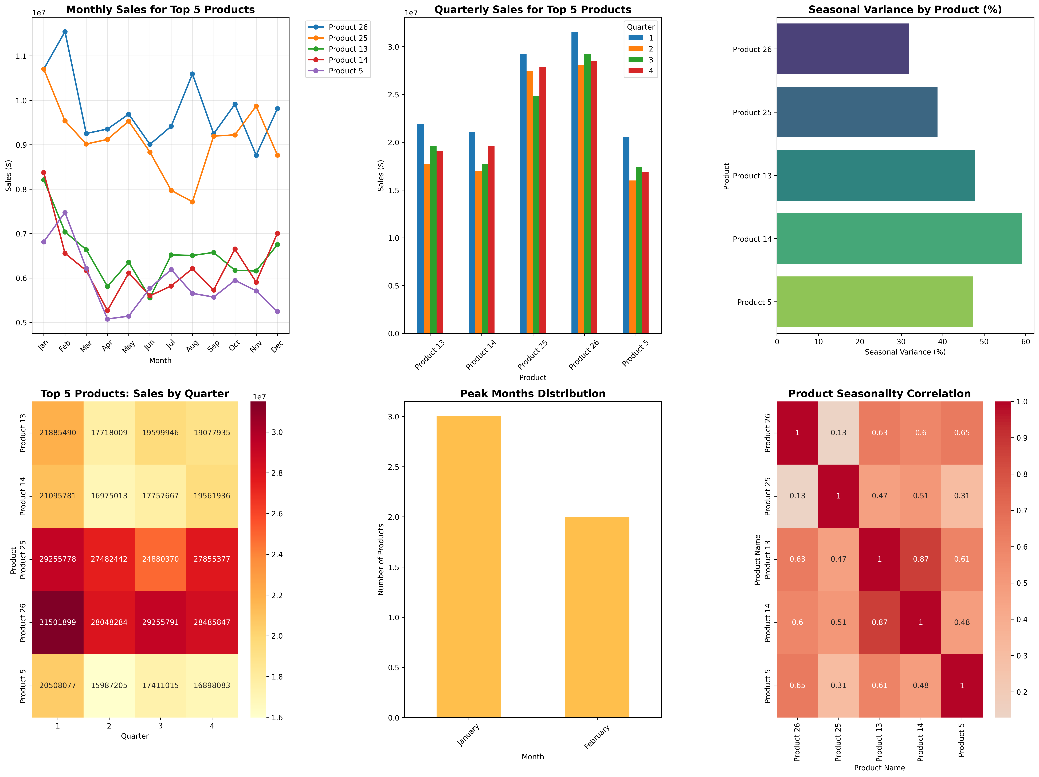
Top products follow the same seasonal pattern as total sales
No major SKU-specific seasonality — top products follow the same ups and downs as total sales.

Slide 13
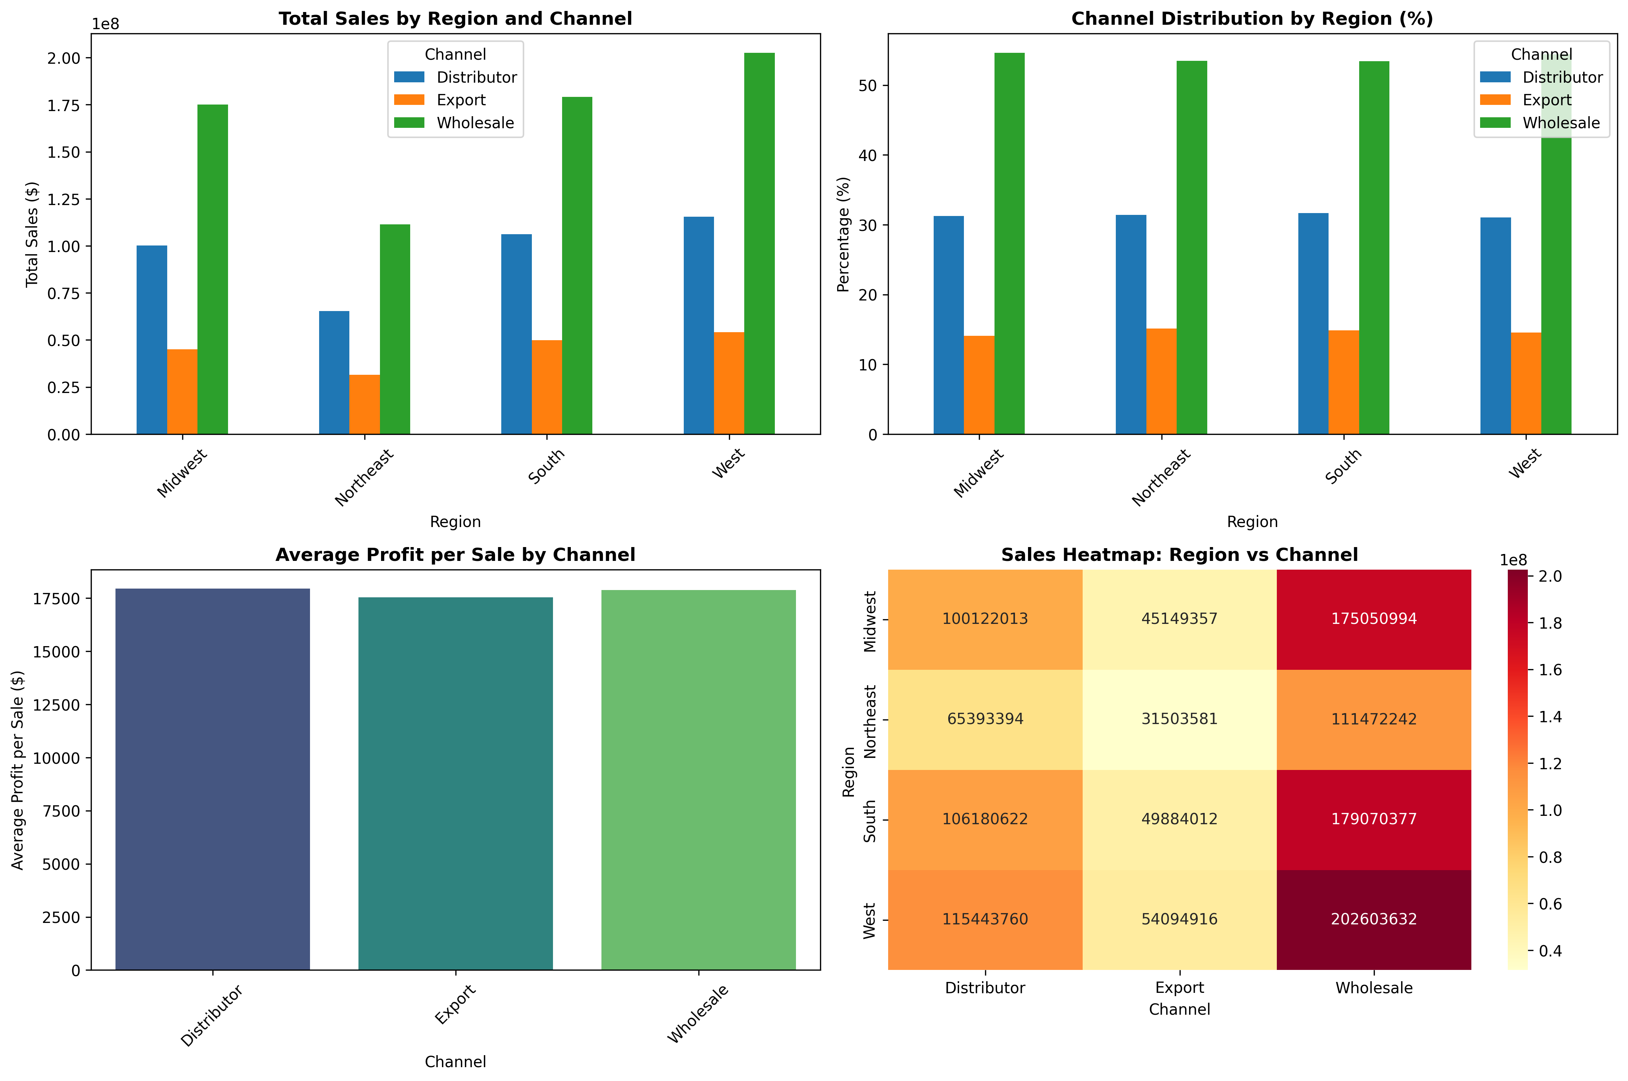
Channel mix and profitability are consistent across regions
Channel mix is stable across regions (≈50% Wholesale, ≈30% Distributor, remainder Export).
Average profit per sale is also similar across channels.”

Slide 14
Recommendations

Slide 15

Grow Market Reach in South & Northeast
Increase number of households buying
Improve territory coverage
Use targeted outreach & repeat-purchase nudges

Slide 16

Scale What Works in Midwest & West
Add capacity & inventory in high-performing regions
Strengthen field staff and operations
Focus especially ahead of Q1 & Q4 peaks

Slide 17

Plan for Seasonality
Stock and staff for the strong Q1 surge
Run promotions to lift Q2–Q3 dip
Prepare ramp-up campaigns for Q4

Slide 18

Focus on top selling products
Ensure best-selling products are available in every region
Replicate West/South product mix in lagging regions
Concentrate marketing on star SKUs

Slide 19

Summary – Next steps
Grow reach in South & Northeast
Scale what works in Midwest & West
Align operations with seasonal demand
Prioritise top-selling SKUs

